Slide 1
Json Best Practice
{ }

Slide 2
What is JSON
JSON stands for JavaScript Object Notation
JSON is a lightweight data-interchange format
JSON is plain text written in JavaScript object notation
JSON is used to send data between computers
JSON is language independent

Slide 3
Why Use JSON
The JSON format is syntactically similar to the code for creating
JavaScript objects. Because of this, a JavaScript program can easily convert JSON
data into JavaScript objects.
Since the format is text only, JSON data can easily be sent between computers,
and used by any programming language.
JavaScript has a built in function for converting JSON strings into JavaScript objects:
JSON.parse()
JavaScript also has a built in function for converting an object into a JSON string:
JSON.stringify()

Slide 4
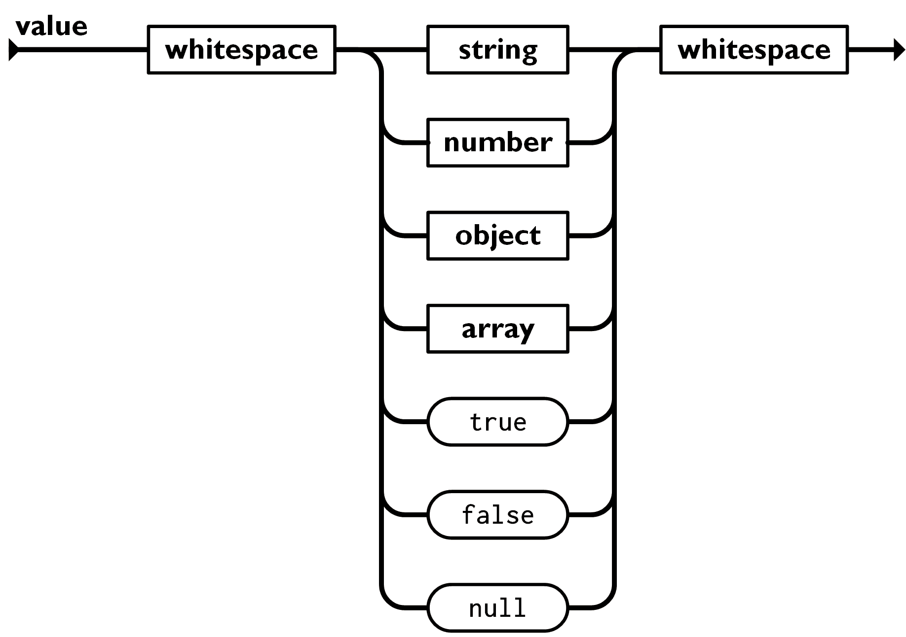

Slide 5
JSON Syntax
JSON syntax is derived from JavaScript object notation syntax:
Data is in name/value pairs
Data is separated by commas
Curly braces hold objects
Square brackets hold arrays

Slide 6
JSON Values
In JSON, values must be one of the following data types:
string
number
object
array
Boolean
null

Slide 7
JSON is Like XML Because
Both JSON and XML are "self describing" (human readable)
Both JSON and XML are hierarchical (values within values)
Both JSON and XML can be parsed and used by lots of programming languages
Both JSON and XML can be fetched with an XMLHttpRequest
JSON is Unlike XML Because
JSON doesn't use end tag
JSON is shorter
JSON is quicker to read and write
JSON can use arrays

